Slide 1



5G OAI Core

Slide 2
Agenda
About whitestack
Why OAI
Previous work
Next steps
Demo

Slide 3













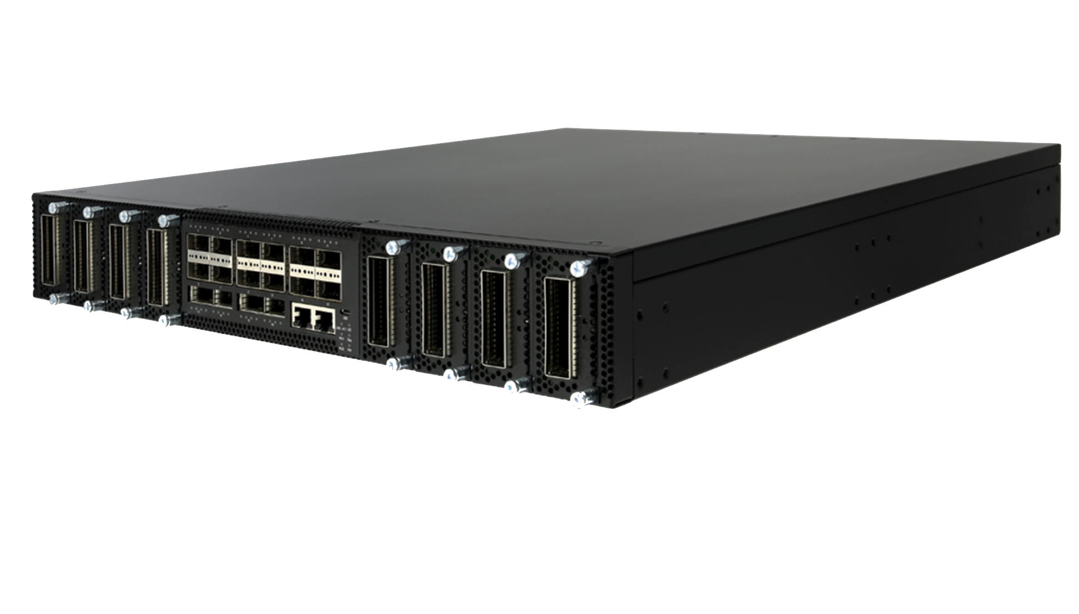


About Whitestack
We build carrier-grade supported products, based on innovative & efficient open technologies
whitesdn
Plug & Play Open-based solutions
MNOs

Slide 4



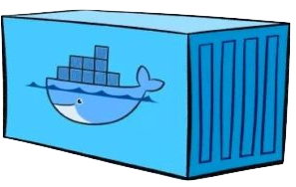








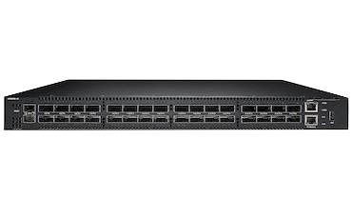


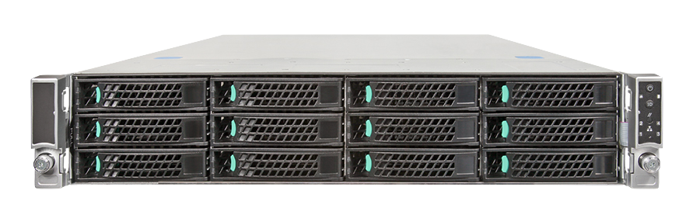

About Whitestack
whiteMON
Performance
and Fault
Management
whitenfv (Telco NFV Orchestration)
atmosphera (Hybrid Cloud Orchestration)
whitemist (Container-Based Cloud)
ESXi & others
Public Cloud
whitecloud (VM-Based Cloud)
Whitebox Switches High-performance Broadcom chipset
COTS Servers Featuring Scalable Processors

Slide 5
Why OAI?
Whitestack detected MNOs need to have non-proprietary 5G SA Core and RAN solutions for different use cases
Whitestack was looking for a 3GPP compliant open-source 5G Core to start testing and develop a product in a near future
OAI has several years of experience working with wireless cellular Radio Access Network (RAN) and Core Network (CN) technologies.
OAI has an active community working on delivering new functionalities all the time (e.g. Open RAN, network slicing, etc)
Whitestack has had good experiences working with OAI in the past over multivendor NFV environments*, so there is high confidence on the joint capabilities to take these solutions to production networks.
* See: First open multi-vendor NFV showcase

Slide 6
Previous work
First step
5G OAI core components
AMF
SMF
NRF
UPF
Additional components
gnbsim
ext-dn network
Deployment method
docker-compose
Infrastructure
1 VM for 5G Core
1 VM for gnbsim
1 VM for ext-dn network
Second step
5G OAI core components
AMF
SMF
NRF
UPF
Additional components
OAI rfsim & nr-ue
ext-dn network
Deployment method
docker-compose
Infrastructure
1 VM for 5G Core
1 VM for rfsim (nr-ue & gnb)
1 VM for ext-dn network

Slide 7
Previous work
Fourth step
5G OAI core components
AMF
SMF
NRF
UPF
UDM
UDR
AUSF
Additional components
OAI rfsim & nr-ue
ext-dn network
Deployment method
helm chart using helm spray
Infrastructure
3 VMs for 5G Core
1 VM for rfsim & nr-ue
1 VM for ext-dn network
Third step
5G OAI core components
AMF
SMF
NRF
UPF
Additional components
OAI rfsim & nr-ue
ext-dn network
Deployment method
helm chart
Infrastructure
3 VMs for 5G Core
1 VM for rfsim & nr-ue
1 VM for ext-dn network

Slide 8
Next steps
Currently we’re working on:
Integration of 5G OAI Core with Istio
Integration of 5G OAI Core with Jaeger
Next steps are:
Test open RAN using 5G OAI Core & RAN
LAB implementation
Using standard gNB
Using oRU for Open RAN
PoC with one MNO in LATAM

Slide 9
Demo
1 VM
K8s Cluster (3 Workers)
1 VM
OAI-UDM
OAI-UDR
OAI-AUSF
OAI-NRF
Control Plane
OAI-AMF
OAI-SMF
OAI-ext-DN
OAI rfsim/nr-ue
OAI-UPF
User Plane

Slide 10

Demo
Deployment method: helm spray
Defines an umbrella chart that controls other charts
Allows us to define the order of charts installation
Allows us to override the values of the charts without modify them
We keep the original OAI charts considering that each deployment is different
We can define the specific order in the chart deployment (e.g. NRF should be deployed before AMF)
Helm spray is just a plugin, easy to install and use
https://github.com/ThalesGroup/helm-spray

Slide 11
Demo
Sequence:
Deploy the 5G Core using helm spray
Check the pod status of each NF
Start the OAI rfsim & NR-UE emulator
Check the logs in 5G Core
Test using iperf for uplink and downlink

Slide 12

Transforming networks with open technologies.
Notes:
Thank you.

