Slide 1
OpenAirInterface RAN Roadmap
Florian Kaltenberger (Eurecom, OSA)
OAI Fall Workshop, 8.12.2021

Slide 2
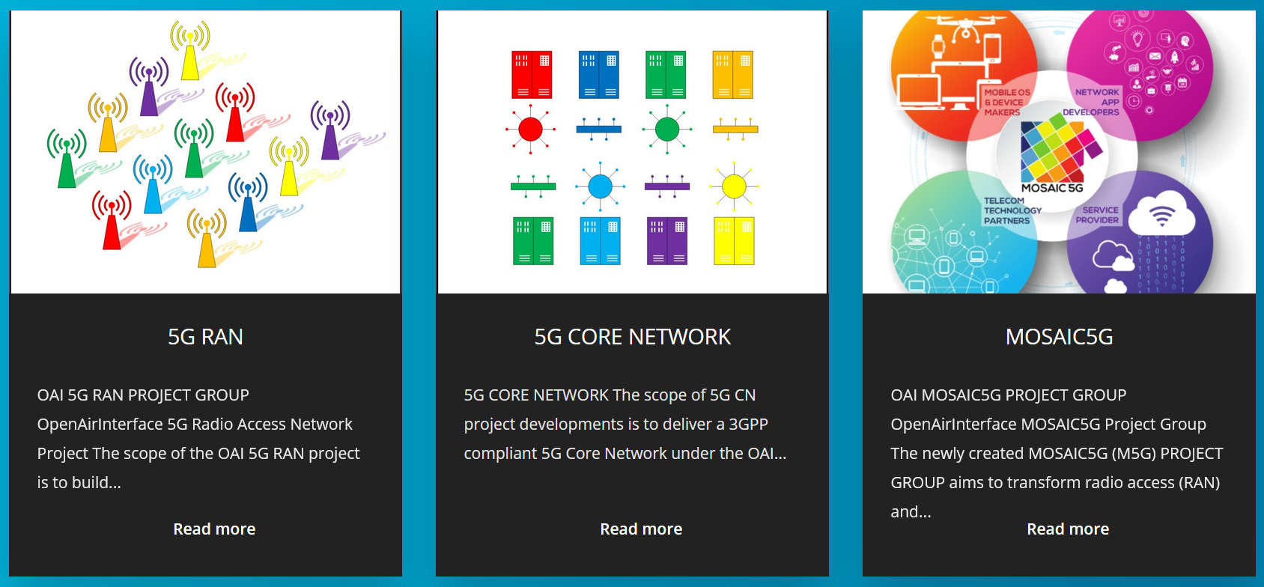
OAI Projects

Slide 3

















5G RAN Project Group
https://openairinterface.org/oai-5g-ran-project/
Sponsors Contributors

Slide 4

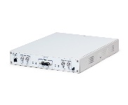
OAI 5G deployment options
Non-standalone (ENDC)
Standalone
EPC
AMF/UPF
S1-U
S1-MME
S1-U
NG-C/U
RAN
RAN
eNB
X2-C
gNB
gNB
gNB-CU
gNB-CU
F1
F1
F1
F1
gNB-DU
gNB-DU
gNB-DU
gNB-DU
Phase 2: EN-DC with COTS UE
Phase 1: “noS1” with OAI UE
Phase 3: SA with COTS UE
Phase 4: SA with OAI UE
OAI UE
OAI UE

Slide 5
OAI gNB features
Subcarrier spacings: 30kHz (FR1), 120kHz (FR2)
Bandwidth: 20/40/50/60/80/100 MHz (FR1), 50MHz (FR2)
Duplexing: static TDD, dynamic TDD, FDD
PHY channels: NR-PSS/NR-SSS, NR-PBCH, NR-PDCCH, NR-PDSCH, NR-CSIRS, NR-PUSCH, NR-PUSCH, NR-PRACH, NR-SRS
SISO & MIMO 2x2
MAC: SIB1, Contention free/Contention based RA procedure, dynamic UL/DL scheduler with HARQ procedures, MCS adaptation from HARQ BLER, CSI-RS, CSI measurement report handling, SR handling
RLC: AM/TM/UM
PDPC: Integrity protection and ciphering procedures
RRC: procedures for SA and NSA
Full list here: https://gitlab.eurecom.fr/oai/openairinterface5g/-/blob/develop/doc/FEATURE_SET.md

Slide 6
Status of 5G NSA development
No split bearer, traffic is redirected to 5G cell
Current performance
80Mbps DL throughput (with 64QAM)
7Mbps UL throughput (with QPSK)
Up to 2 users tested
Tested Core networks
OAI EPC
Nokia LTEbox
Tested UEs:
Oppo Reno 5G
Samsung A90 5G
Samsung A42 5G
Google Pixel 5G

Slide 7
FR2 NSA status
Basic development of PHY & MAC for FR2 done
120kHz subcarrier spacing
Beamforming support (using GPIO to control external RF)
Transmission of multiple SSBs
Support for multiple PRACH occasions for initial beam correspondence.
Tests with OAI gNB + OAI UE ok
Using intermediate frequency ~5GHz
Real-time operation ok
Initial beam selection ok
Interoperability with COTS phone: not yet
Phone not even seeing 5G cell during inter-RAT measurements

Slide 8
Status of 5G SA development
Current performance with COTS UE
Latency: 9ms (mean)
Stability: up to 1h (without pushing traffic too much)
80Mbps max DL throughput
7Mbps max UL throughput
Validated Core networks
OAI 5GC and
Nokia Sabox
Free CN
Tested UEs
Simcom SIMCOM8200EA
Quectel RM500Q-GL
Huawei Mate 30 pro (limited)
OAI UE

Slide 9
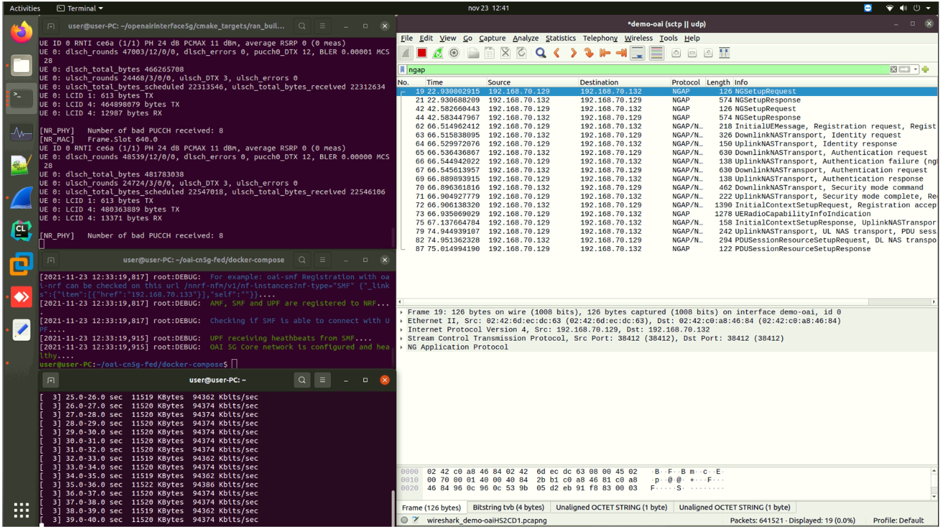

gNB
gNB ↔ CN5G
CN5G

Slide 10
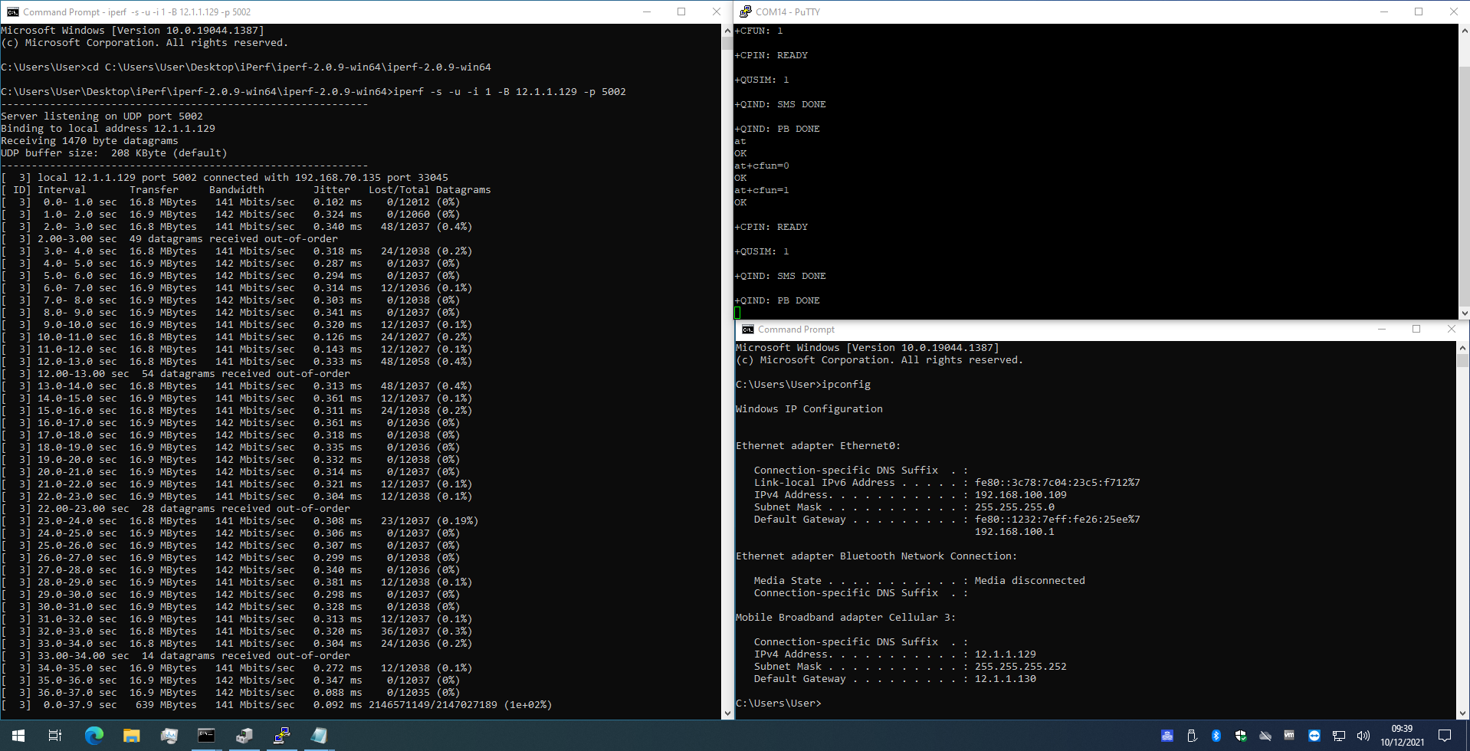
COTS UE
(Quectel)
60MHz (162PRBs), 30kHz SCS, 6DL/1S/2UL slots, SISO

Slide 11
SA UE
Supporting "noS1" mode (DL and UL):
Creates TUN interface to PDCP to inject and receive user-place traffic
No connection to the core network
Supporting Standalone (SA) mode:
UE can register with the 5G Core Network, establish a PDU Session and exchange user-plane traffic
Testing with rfsimulator and USRP
Throughput currently limited but will be improved
Notes:
OpenAirInterface 5G-NR UE Feature Set
Supporting "noS1" mode (DL and UL):
Creates TUN interface to PDCP to inject and receive user-place traffic
No connection to the core network
Supporting Standalone (SA) mode:
UE can register with the 5G Core Network, establish a PDU Session and exchange user-plane traffic
NR UE PHY Layer
Initial synchronization
Time tracking based on PBCH DMRS
Frequency offset estimation
30KHz SCS for FR1 and 120 KHz SCS for FR2
Reception of NR-PSS/NR-SSS
NR-PBCH supports multiple SSBs and flexible periodicity
Reception of NR-PDCCH (including reception of DCI, polar decoding, de-scrambling, de-modulation, RB de-mapping, etc)
common search space configured by MIB
user-specific search space configured by RRC
DCI formats: 00, 10, 01 and 11
Reception of NR-PDSCH (including Segmentation, LDPC decoding, rate de-matching, de-scrambling, de-modulation, RB de-mapping, etc).
PDSCH mapping type A and B
DMRS configuration type 1 and 2
Single and multiple DMRS symbols
PTRS support
Support for 1, 2 and 4 RX antennas
Support for up to 2 layers (currently limited to DMRS configuration type 2)
NR-PUSCH (including Segmentation, LDPC encoding, rate matching, scrambling, modulation, RB mapping, etc).
PUSCH mapping type A and B
DMRS configuration type 1 and 2
Single and multiple DMRS symbols
PTRS support
Support for 1 TX antenna
Support for 1 layer
NR-PUCCH
Format 0 (2 bits for ACK/NACK and SR)
Format 2 (up to 64 bits, mainly for CSI feedback)
Format 1, 3 and 4 present but old code never dested (need restructuring before verification)
NR-PRACH
Formats 0,1,2,3, A1-A3, B1-B3
NR-SRS
Old code never dested (need restructuring before verification)
SS-RSRP
RSRP measured on synchronization SSB (ok only for single SSB)
Highly efficient 3GPP compliant LDPC encoder and decoder (BG1 and BG2 are supported)
Highly efficient 3GPP compliant polar encoder and decoder
Encoder and decoder for short block
NR UE FAPI
MAC -> PHY configuration via UE FAPI P5 interface
Basic MAC to control PHY via UE FAPI P7 interface
PHY -> MAC indication (needs some improvement)
NR UE Higher Layers
UE MAC
Minimum system information (MSI)
MIB processing
Scheduling of system information block 1 (SIB1) reception
Random access procedure (needs improvement, there is still not a clear separation between MAC and PHY)
Mapping SSBs to multiple ROs
Scheduling of PRACH
Processing of RAR
Transmission and re-transmission of Msg3
Msg4 and contention resolution
DCI processing
format 10 (RA-RNTI, C-RNTI, SI-RNTI, TC-RNTI)
format 00 (C-RNTI, TC-RNTI)
format 11 (C-RNTI)
format 01 (C-RNTI)
UCI processing
ACK/NACK processing
Triggering periodic SR
CSI measurement reporting (SSB RSRP only)
DLSH scheduler
Configuration of fapi PDU according to DCI
HARQ procedures
ULSCH scheduler
Configuration of fapi PDU according to DCI
UE RLC
Tx/Rx operations according to 38.322 Rel.16
Segmentation and reassembly procedures
RLC Acknowledged mode supporting PDU retransmissions
RLC Unacknowledged mode
DRBs and SRBs establishment and handling
Timers implementation
Interfaces with PDCP, MAC
UE PDCP
Tx/Rx operations according to 38.323 Rel.16
Integrity protection and ciphering procedures
Sequence number management, SDU dicard and in-order delivery
Radio bearer establishment/handling and association with PDCP entities
Interfaces with RRC, RLC
UE RRC
Integration of RRC messages and procedures supporting UE 5G SA connection according to 38.331 Rel.16
RRCSetupRequest/RRCSetup/RRCSetupComplete
RRC Uplink/Downlink Information transfer carrying NAS messages transparently
RRC Reconfiguration/Reconfiguration complete
Support for master cell group configuration
Interface with PDCP: configuration, DCCH and CCCH message handling
Interface with RLC and MAC for configuration
UE NAS
Transfer of NAS messages between the AMF and the UE supporting the UE registration with the core network and the PDU session establishment according to 24.501 Rel.16
Identity Request/Response
Authentication Request/Response
Security Mode Command/Complete
Registration Request/Accept/Complete
PDU Session Establishment Request/Accept
NAS configuration and basic interfacing with RRC

Slide 12
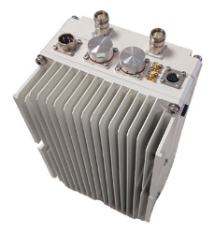
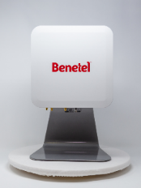
Functional splits in OAI 4G/5G
CU
F1-C and F1-U
Revised implementation under integration
Interoperability testing with Acceleran ongoing
5G FAPI
today all L1 procedures compliant with SCF 5G FAPI
5G nFAPI
Fronthaul
eCPRI (with AW2S)
O-RAN 7.2 U-plane done (with Benetel)
O-RAN 7.2 S/C-plane ongoing
Interoperability with other RRUs (Mavenir, Foxconn) planned for beginning 2022
3GPP F1
DU
MAC/RLC
SCF 5G FAPI
PHY
O-RAN 7.2
eCPRI
RRH
Notes:
The status is the following:-F1-C (control plane) is enabled for 5G SA. This includes the exchange of the initial F1 setup messages between the CU and the DU, as well as their configuration updates; the transparent transfer of DL/UL RRC messages between the CU and the UE through the DU; the UE context management procedures exchanged between the CU and the DU; the establishment of GTP-U tunnels between the CU and DU, required for enabling user-plane traffic transfer over F1-U. These procedures allow to support the end-to-end UE attachment to the core network and the PDU Session establishment in CU/DU split deployment mode.-F1-U (User plane) is enabled for 5G SA. The new implementation of gtp-u has been updated to support user plane traffic over both N3 and F1-U interfaces concurrently. First IP traffic tests between the UE and the core network over F1-U have been successfully validated. Next steps will be to extend F1-C mainly with more UE context management procedures as per TS 38.473 Rel. 16, in the context of some planned interoperability tests between our DU and a commercial CU.
CI tests definded and to be set up
MR to be opened
Next: interoperability testing with AccelerRAN

Slide 13

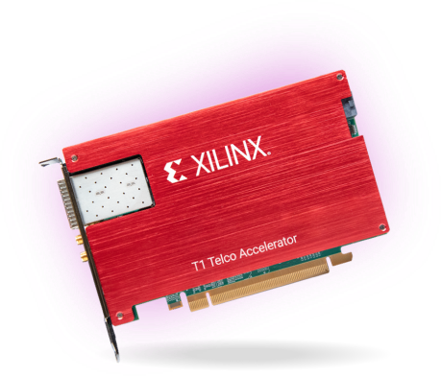
T1 LDPC Offload
MAC/RLC
Channel coding/decoding consumes most energy/processing time
91% of total RX processing time in OAI
Xilinx T1 accelerator card
Contains ZU19EG MPSoC and ZU21DR RFSoC
Offload of forward error correction and fronthaul
Bitstream and drivers provided by VVDN
LDPC channel decoding integrated in OAI
Works with nr_ulsim and nr-softmodem
Integration in develop ongoing
SCF 5G FAPI
PHY
FH
FEC
DPDK
BBDEV
O-RAN 7.2 C/U/S
RRU

Slide 14
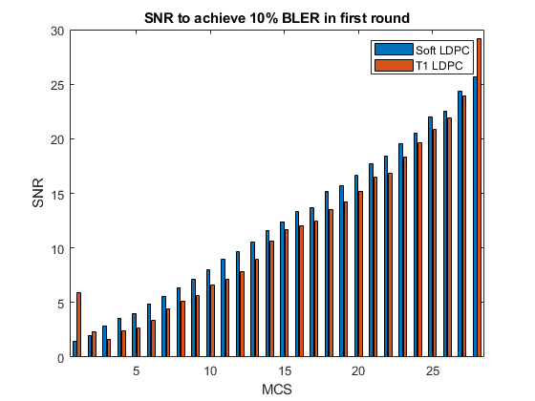
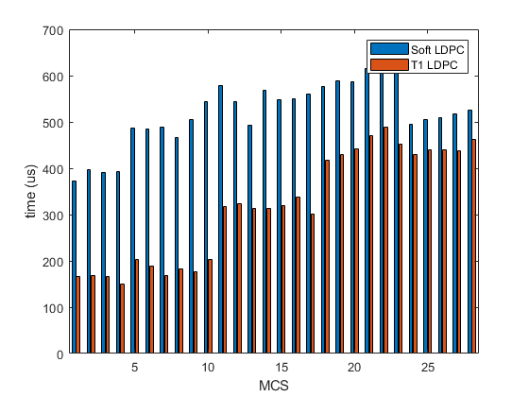
T1 LDPC Offload
See demo during second session
execution time
NR-PUSCH, SCS 30kHz, 106PRB, 12OFDM symbols, 1 DRMS, SISO, TDL-C channel
Florian Kaltenberger, Hongzhi Wang, Saktivel Velumani, “Performance evaluation of offloading LDPC decoding to an FPGA in 5G baseband processing,” Workshop on Smart Antennas (WSA2021), Sophia-Antipolis, France, 10-12.11.2021.

Slide 15

L2 emulator for 4G and 5G NSA
Old L2 emulator replaced by more modular design
Based on 4G and 5G nFAPI
Channel proxy
NSA UE
Many bugfixes and performance improvements, especially for multiple UEs
Under integration in develop

Slide 16


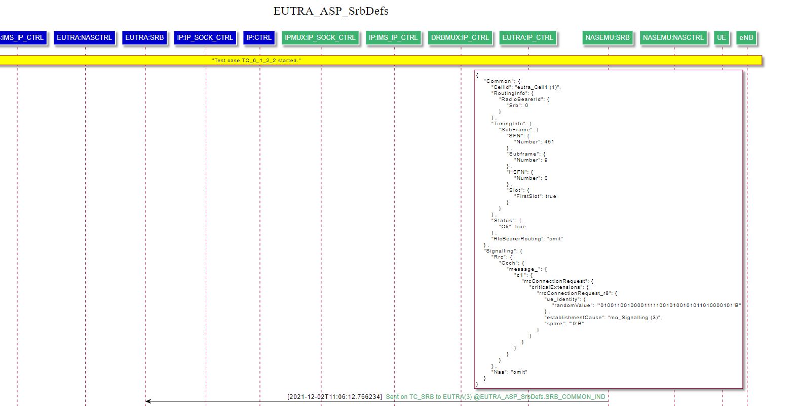
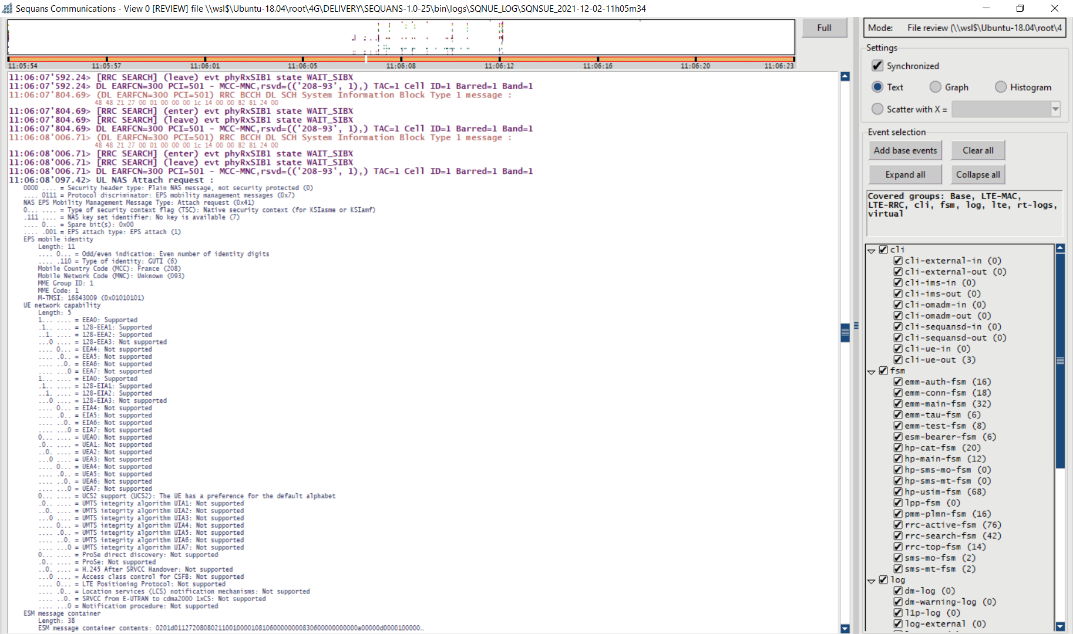
OAI4test project
Objectives
develop an automatic protocol tester for UEs (4G and 5G) based on OAI
compatible with TTCN tests defined by ETSI/3GPP
TTCN executable
TTCN logger
SRB port
SYS port
IDL interface
Sequans UE
logger
NFAPI interface
FAPI interface
SQNS UE
PROXY
eNB

Slide 17
OAI4test project
Objectives
develop an automatic protocol tester for UEs (4G and 5G) based on OAI
compatible with TTCN tests defined by ETSI/3GPP
Achievements
TTCN Sequans test framework (4G control plane), working in front of OAI eNB/proxy (L2 simulator) with Sequans 4G UE legacy simulator (3GPP certified)
Able to run 3GPP 36523 6.1.2.2 (Cell selection / Qrxlevmin), TS 36.508 subclause 4.5.2.3 fully covered.
Working on eNB configuration from TTCN (ASPs from 3GPP 36523-3 on TTCN EUTRA SYSTEM port)
Starting to work on TTCN 5G test framework
Notes:
Firecell is leading the enhancement of OAI to support TTCN test cases
Introduce Virtual Time management on Proxy with Frame/SubFrame Acknowledge with UE. This enable the system to produce stable validation results
Extend interface with UE in order to provision RSRP/RSRQ value to enable cell selection
Implementation of system adapter APIs for SYS and SRB port.

Slide 18
5G non-terrestrial networks (Rel 17)

Slide 19
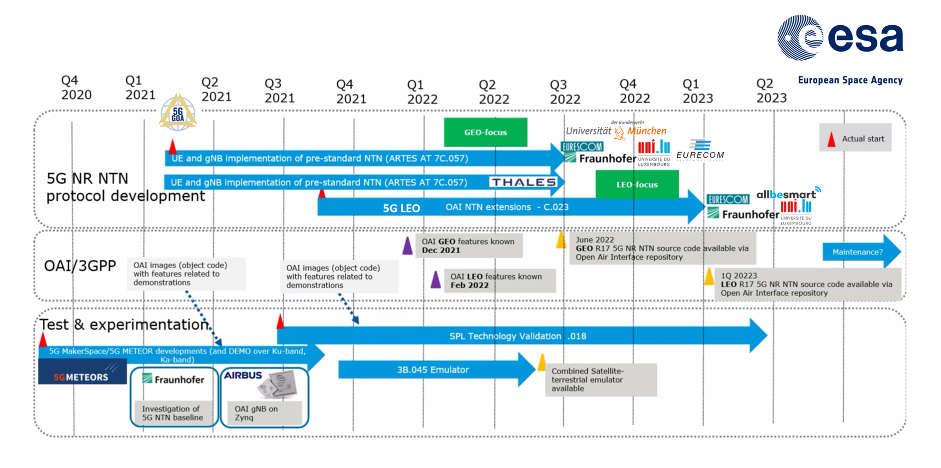
5G NTN roadmap

Slide 20
Status of 5G NTN developments
Rel15 and Rel16 features necessary for NTN already part of public OAI repository
FDD support
Multiple DMRS support
Phase Tracking Reference Symbols support
10MHz bandwidth support
Initial development (5G GOA project) → to be merged Q2 2022 (after Rel 17 freeze)
PHY Layer
Consider timing relation for UL scheduling at gNB
Extension of RAR window
Extend OAI rf-simulator to support simulation of long delay
Disable HARQ at gNB and UE
Support for 5 MHz BW with 15 kHz SCS
Testing/fixing OAI 5G NR SA with all the NTN features
MAC Layer
Uplink timing advance and RA procedure
FDD Scheduling
Multi-UE Support
QoS scheduling
Next steps (5G LEO project)
Xn Handover between transparent LEO satellites
…

Slide 21
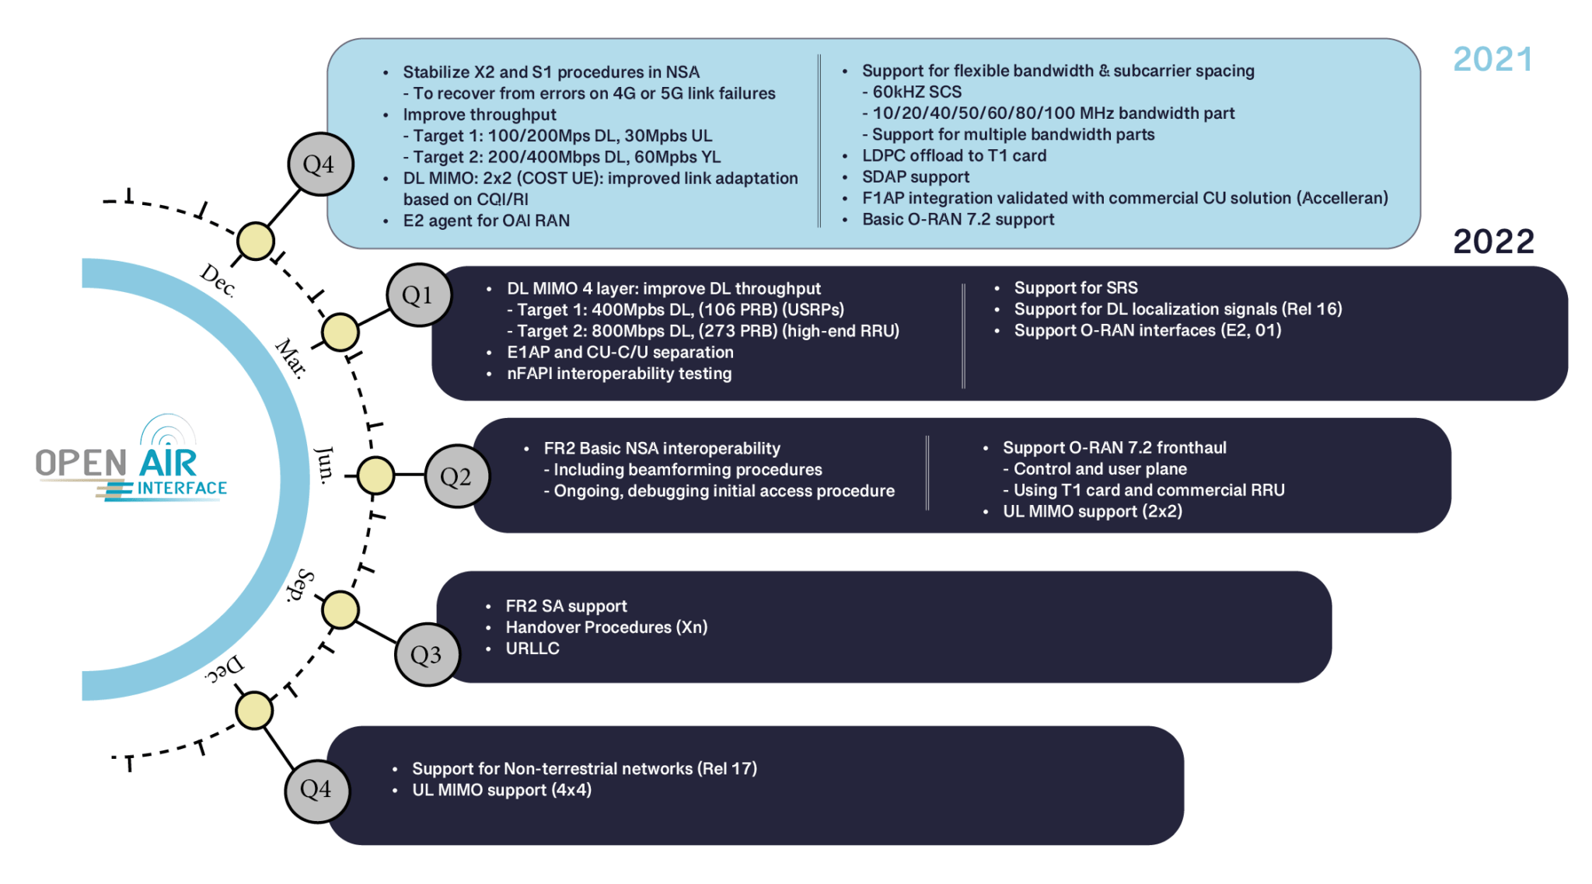

Slide 22



5G Core Project Group
https://openairinterface.org/oai-5g-core-network-project/
Sponsors Contributors

Slide 23
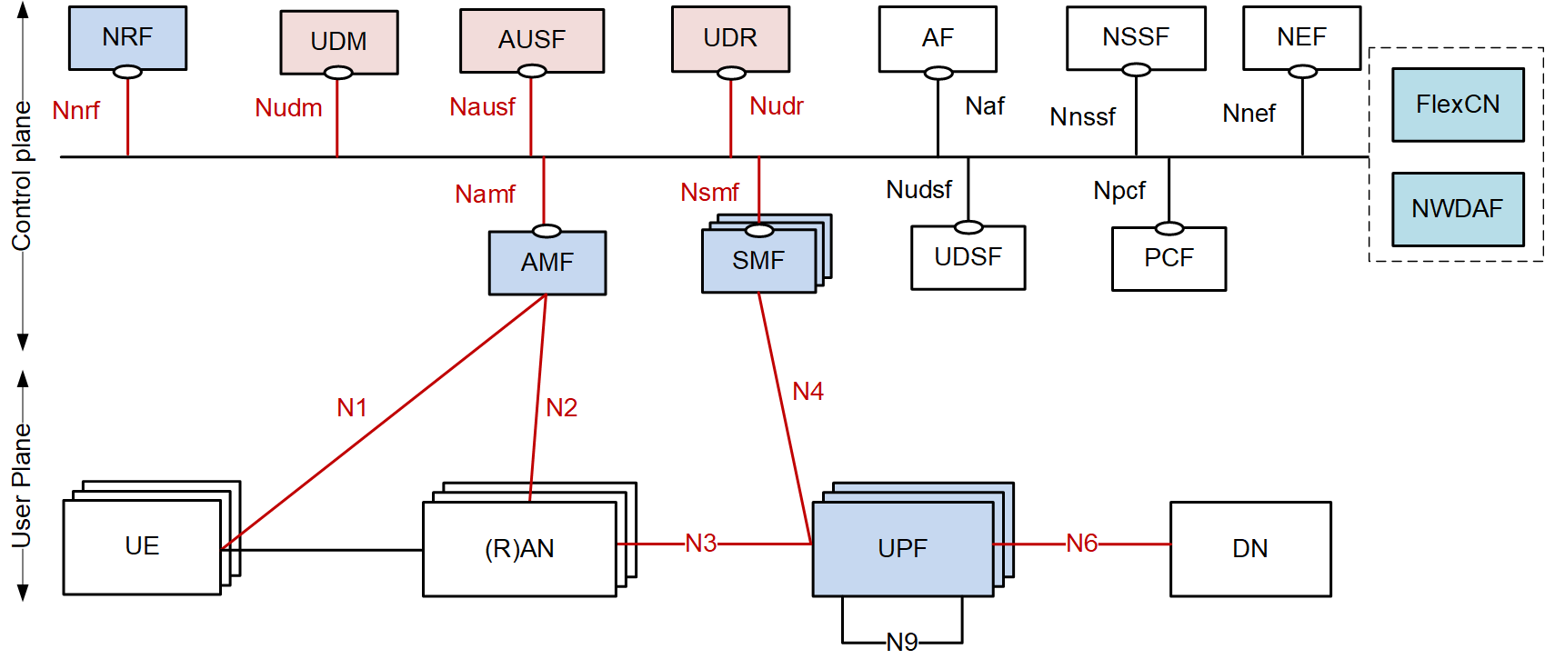
OAI 5G CN – Current Status
A solid and functional 5GC
Basic procedures (with multiple UEs/multiple PDU sessions): connection and registration procedures, session management procedures
Additional features: NF registration, NF discovery (e.g., to discover and select SMF, UPF), N2 handover, Paging, HTTP/2, FQDN support
Validation, CI/CD with
Professional tester (dsTest, Developing Solutions):
Testing AMF, SMF and UPF with simulated gNB/UE
Bracket test for AMF, SMF (e.g., testing AMF with simulated SMF/UPF/gNB/UE)
OAI gNB/OAI UE ( + Quectel/SIMcom modules)
Commercial gNBs (Amarisoft/Baicell) /COTS UEs/Amarisoft UEs
Open-source RAN simulators (gNBSim, UERANSIM)
OAI CN Progress Update Call
23
Notes:
23

Slide 24
OAI 5G CN – Current Status
Two 5GC modes
Minimal 5GC with AMF, SMF, NRF and UPF
Basic 5GC with AMF, SMF, NRF, UPF, UDM, AUSF and UDR
Three UPF flavors:
SPGW-U (from 4G) with additional features for 5G
VPP-UPF (relying on VPP-Travelping, with DPDK support)
Production grade UPF (Kaloom, on-going)
Deployment, CI/CD
Traditional/classic deployment on Servers/Virtual machines
Automated deployment of NFs in Docker containers using Docker Compose
Could-native deployment using Helm Chart on OpenShift cluster
OAI CN Progress Update Call
24
Notes:
24

Slide 25
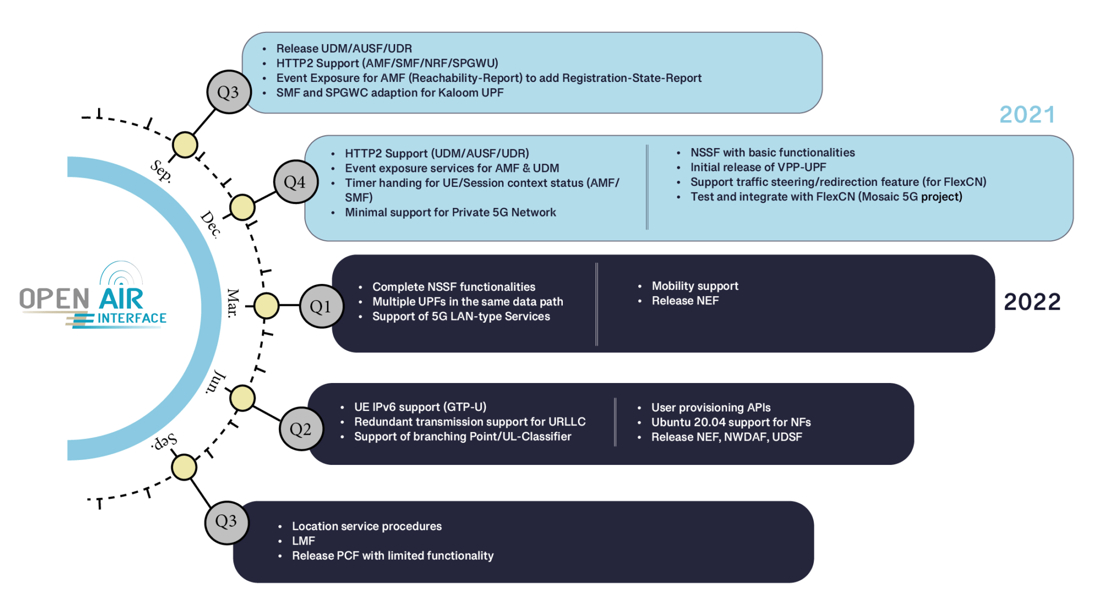

Slide 26
OAI 5G SA demo

Slide 27

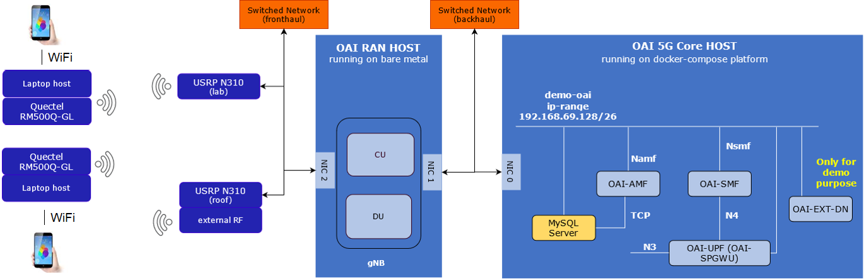
5G NR Standalone Demo Setup

Slide 28

Video comes here

Slide 29

Thank You

