Slide 1

Fall 2021 OpenAirInterface Workshop: Lab3 - Network slicing with OAI 5G CN
Tien Thinh NGUYEN
Notes:
<number>

Slide 2
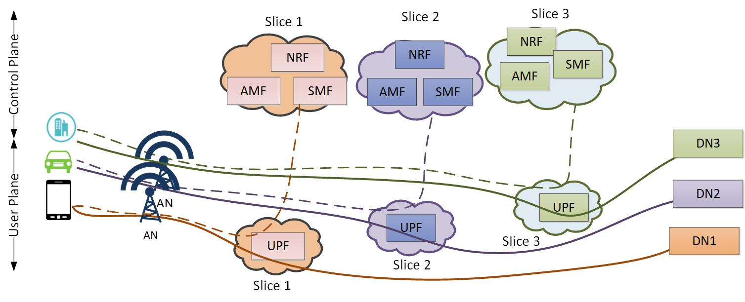
Network Slicing - Overview
Overview of Network Slicing
As a crucial enabler to realize the service-oriented 5G vision
Allow multiple logical networks to be created on top of a common shared physical infrastructure
Multiple Network Slice instances delivering the same features but for different group of UEs/Services
A Network Slice is identified by an S-NSSAI with:
A Slice/Service Type (SST): refers to the expected Network Slice behavior in terms of features and services. Some standardized SST values: eMMB, URLLC, MIoT, V2X
A Slice Differentiator (SD): Differentiate amongst multiple Network Slices of the same SST
Fall 2021 OAI Workshop: Lab3
<number>
Notes:
<number>

Slide 3
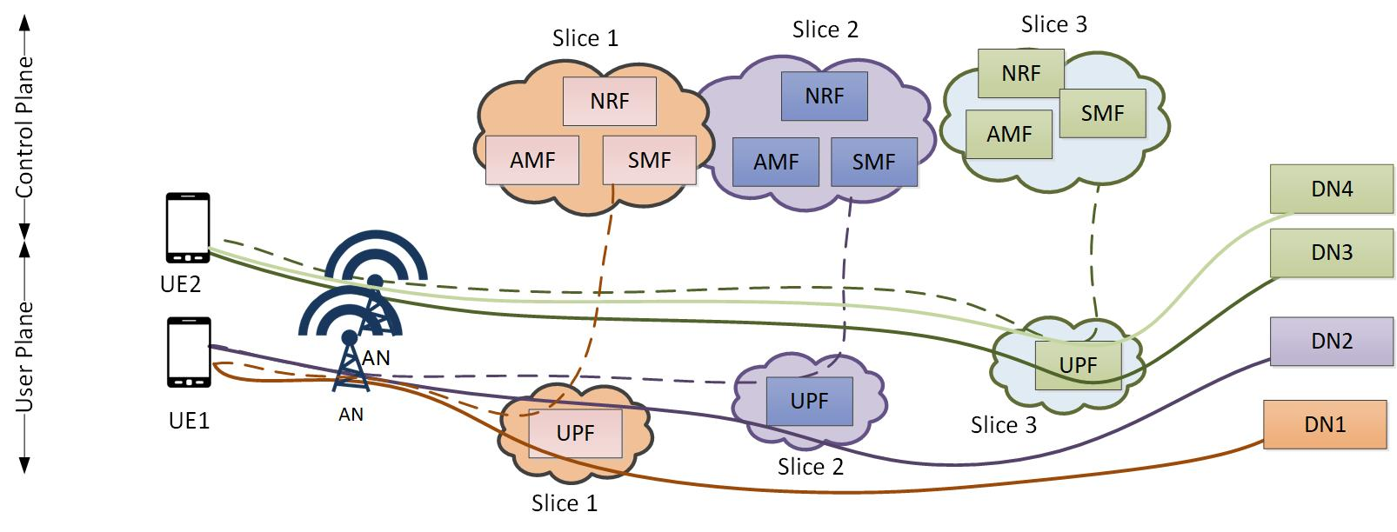
Network Slicing with OAI 5G CN (1)
Network slicing with OAI 5G CN
With NSSF: Discover and select an appropriate AMF to support the requested slice (AMF re-allocation procedure (available Q1 2022))
With NRF: Discover and select SMF/UPF for the requested slice (for a particular PDU session)
Per UE and per PDU session
Fall 2021 OAI Workshop: Lab3
<number>
Notes:
<number>

Slide 4
Network Slicing with OAI 5G CN (2)
Preparation and Instantiation
NFs are configured to support a set of Network slices (SST, SD) in the configuration/yaml file
(automatic via a management and orchestration tool e.g., OSM, Trirematics (Mosaic5G project))
Network slice selection
Discover and select an appropriate AMF to support the requested slice (with NSSF and AMF re-allocation feature (available Q1 2022))
Discover and select SMF/UPF for the requested slice (for a particular PDU session)
NRF
NSSF
AMF1
AMF2
SMF1
SMF2
UE
RAN
UPF1
UPF2
DN
Fall 2021 OAI Workshop: Lab3
<number>
Notes:
<number>

Slide 5
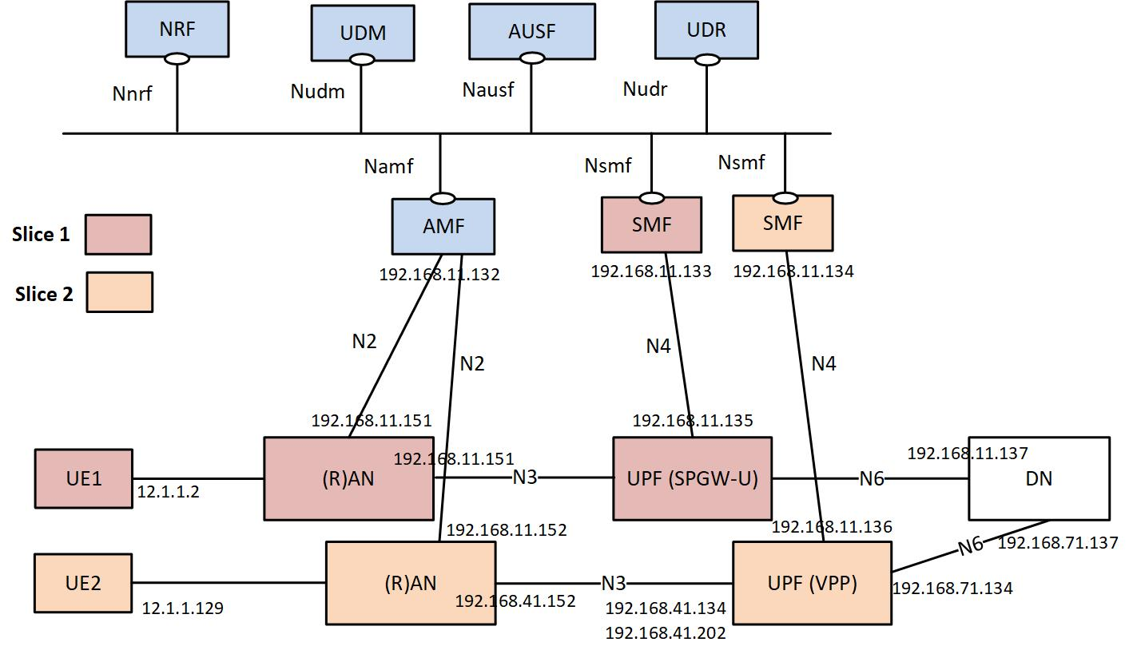
Lab 3: Network slicing with OAI 5G CN (1)
Lab environment
With basic deployment: AMF, SMF, UPF, NRF, UDM, AUSF, UDR
With gNBSim (gNB/UE)
2 Network Slices
Common NFs: AMF, NRF, UDM, AUSF, UDR,
Slice 1 (SST=128, SD=128): UE1 (session 1), gNB1, SMF1, UPF1 (SPGWU)
Slice 2 (SST=129, SD=129): UE2 (session 1), gNB2, SMF2, UPF2 (VPP-UPF)
Fall 2021 OAI Workshop: Lab3
<number>
Notes:
<number>

Slide 6
Lab 3: Network slicing with OAI 5G CN (2)
Lab description
Deploy 5G CN with predefined scenario (with yaml file for 5G CN)
Deploy two gNBs with gNBSim (with yaml files for gNBSim)
Verify the logs
Ping from UEs/DNs to the DNs/UEs to verify the data path
Capture the packets with
Tshark: sudo tshark -i any 'net 192.168.11.0/24 or net 192.168.41.0/24 or icmp or sctp and not arp and not tcp’
Tcpdump (Please don’t do it now!)
sudo tcpdump -i any '(net 192.168.11.0/24 or net 192.168.41.0/24 or net 192.168.71.0/24 or net 12.1.1.0/24)' -vv -X -w lab3.pcapng
Filter with Wireshark: http or sctp or pfcp or icmp
Fall 2021 OAI Workshop: Lab3
<number>
Notes:
<number>

